Slide 1



PREDICTING HEALTH OF AUTOMOTIVE VEHICLE ENGINE

Slide 2

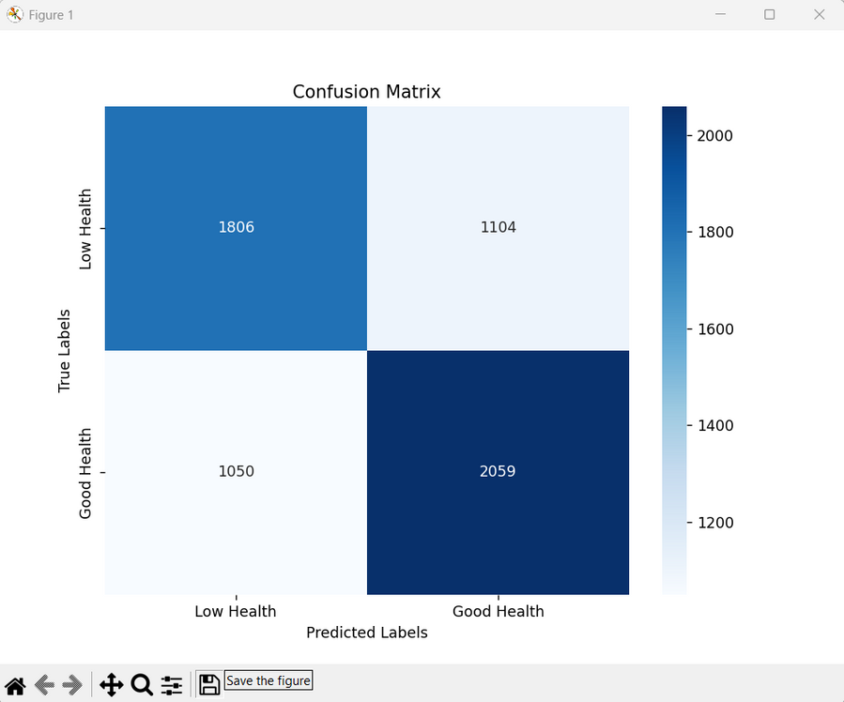
CONFUSION MATRIX

Slide 3

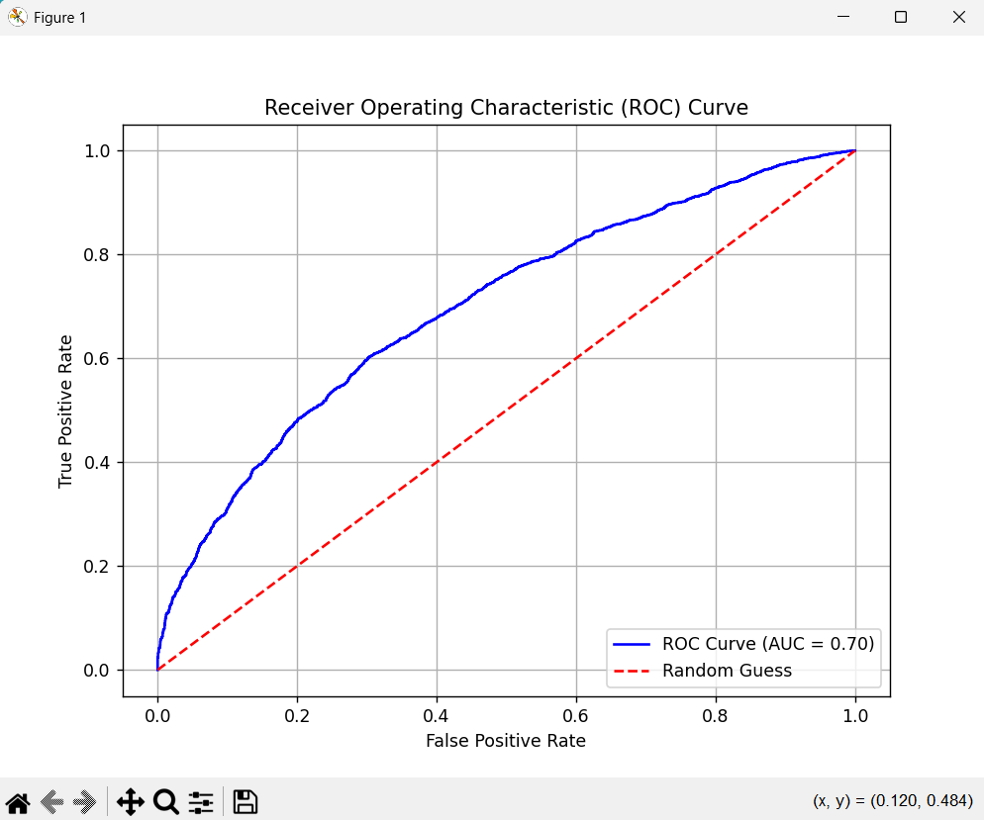
ROC CURVE

Slide 4

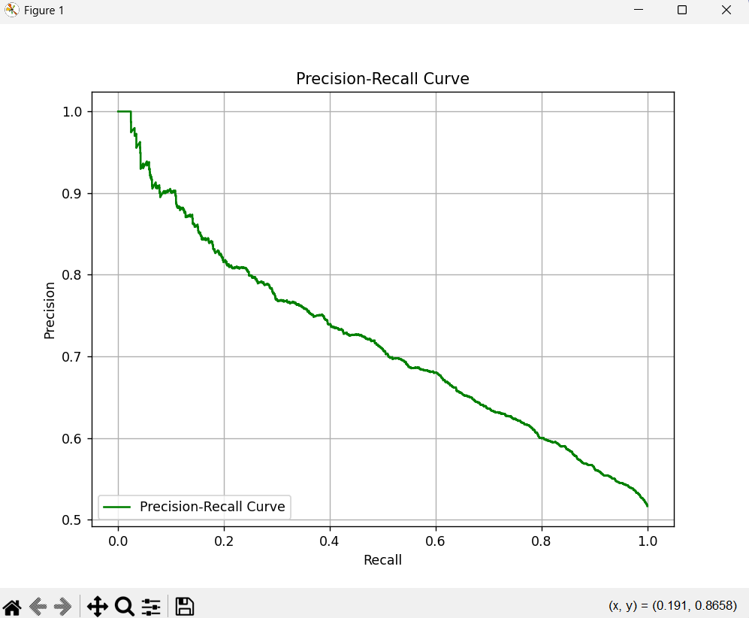
PRECISION-RECALL CURVE

Slide 5
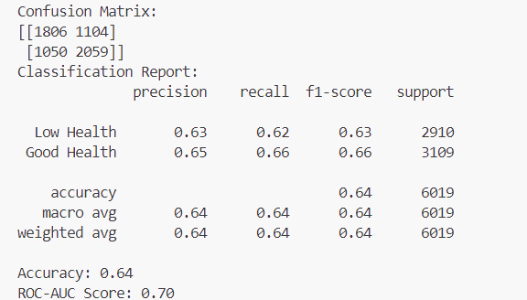
PERFORMANCE

Slide 6
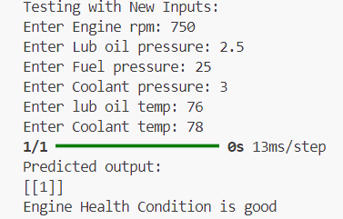
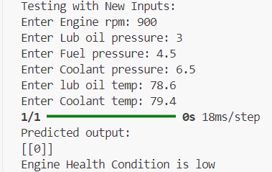
EXAMPLE OF USER INPUT

Slide 7
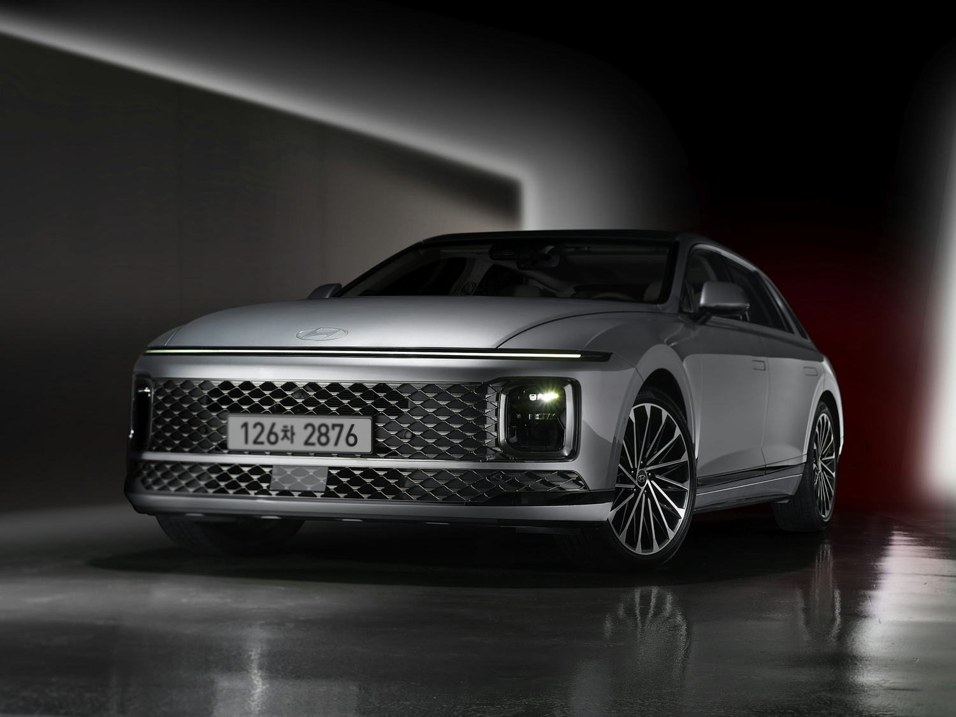
THANK YOU

